Slide 1
Welcome
STC Course
Science and Technology of Consciousness
For Computer Professionals
September 2020

Slide 2
STC is the foundational course for Computer Science and all disciplines taught at MUM
Theoretical and practical applications for the full development of the individual
Notes:
The main goal of the Science and Technology of Consciousness course is the full development of the individual for the purpose of living fulfillment in life. During this course, knowledge and experience complement each other—both are needed for the complete development of consciousness.
Our classroom lectures and exercises are complemented by the twice-daily group practice of the Transcendental Meditation technique, which open one’s awareness to the experience of the pure field of creative intelligence, which enriches all aspects of our life.

Slide 3
Class Times
10:00 am – 12:15 pm
1:15 pm – 3:15 pm
Attendance at all classes is required
Please be Punctual
Notes:
Course procedures and guidelines are outlined in the first four pages of your syllabus – it’s important that you know them. I want to take a couple minutes before we introduce your professors to go over some of the more important points.
Attendance at all classes is required because all elements of class—lectures, questions and answers, discussions and homework assignments —contribute to the learning process
Students are expected to arrive 2 or 3 minutes before class time so everyone can be seated and settled when class begins.
Absences are usually excused only if students are sick in bed or have a family emergency. If you miss more than three sessions (morning or afternoon) of the two-week course, you may not be eligible to receive credit for the course. If you must miss a class, please call or email your professor, or send a note with a friend. Simply not showing up is unprofessional and discourteous and will be considered an unexcused absence.

Slide 4
Computers, cell phones, and other devices
Research is showing that being without cell phones creates a positive effect on classroom atmosphere, improved concentration on classroom activities, and more respectful classroom atmosphere. Students found they participated significantly more in class exercises and discussions, and scored higher on quizzes and essays.
Notes:
So this is the outcome we want in this course. There’s also research showing that taking notes with pen and paper actually helps students retain information better.
Use of electronic devices in the classroom is not allowed. We know how attached you are to your smart phones, music players and tablets - but we must ask that you do not use your devices during class time or during groups meditations.

Slide 5
This Course will be Graded Pass/No Pass
Grading
Weighted Components of the Course:
Daily Homework 35%
Participation 35%
Oral Quiz 10%
Oral Exam 20%
Notes:
The assignment for the day is due no later than 9:30am of the next scheduled class.
The STC course will help prepare you for your graduate program here at MUM.
The assignments are directed towards critical and creative thinking and you should have a good amount of writing practice to develop your skills.
The homework assignments are listed in Sakai and in your syllabus.
All work submitted during this course and throughout your graduate program at MUM should be your own. Do not, under any circumstance, use another's work or words and submit it as your own. Academic dishonesty and plagiarism are serious academic offenses. Here at M.U.M., you will get an NC on any homework that you have copied or plagiarized.

Slide 6
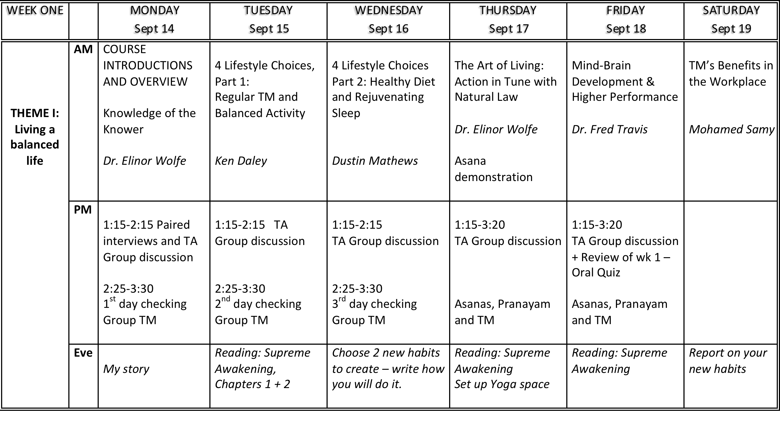

Slide 7
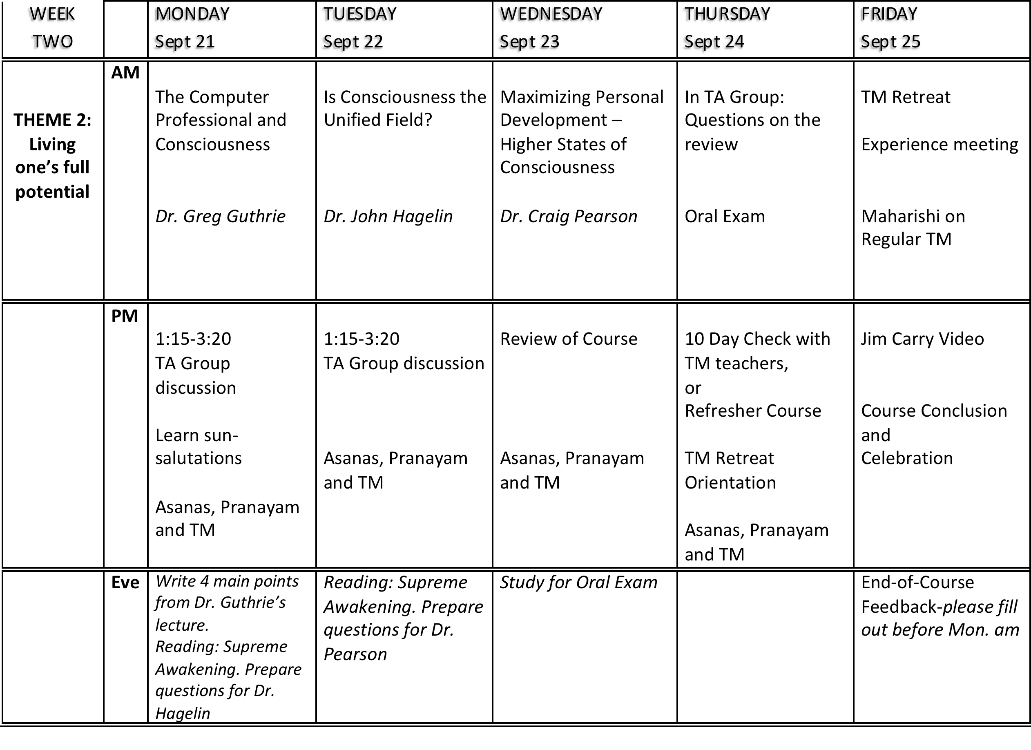

Slide 8

A Scientific Meditation?
Notes:
So what is STC? What is the Science and Technology of Consciousness? Why do we use these words: science and technology, for something usually thought of as philosophical or as a very subjective, personal experience?
Science has two aspects: Theory, or intellectual understanding, and practical applications or technologies. Just as Computer Science consists of theory like recursion and algorithms, and practical applications like Java, so STC also consists of theory, in the form of the intellectual understanding of the field of consciousness, and practical applications - its principal technology, TM.
The Science and Technology of Consciousness takes the understanding of meditation from the cloudy realm of mystery into the precise light of science, making what had seemed improbable and impractical now documented and realistic.
Almost from the beginning, the founder of TM and this university encouraged scientific research on TM. We live in a scientific age – If the effects of meditation are real, they should be measurable.
There have been 378 peer-reviewed studies that have been published in professional journals after having passed the highest standards of the experts who constitute their review boards, which verify that the practice of TM has wide-ranging benefits for the mind and body.
But even with all the science to back it up, it’s taken time for meditation to be accepted as an intervention for many of the problems that face humankind today. But after 50 years, meditation is now accepted as an important tool to keep modern life from spinning out of balance. This required a paradigm shift. Do you know what a paradigm is?

Slide 9


What is a paradigm?
Notes:
A paradigm is the framework that creates the way you see the world. You’ve heard the saying, ‘The world is as you are’, or ‘We don’t see things are THEY are, we see them as WE are”. If we look through green glasses we see the world green. If we have a positive outlook, we’ll see the world as a positive place. It all depends on our vision.

Slide 10
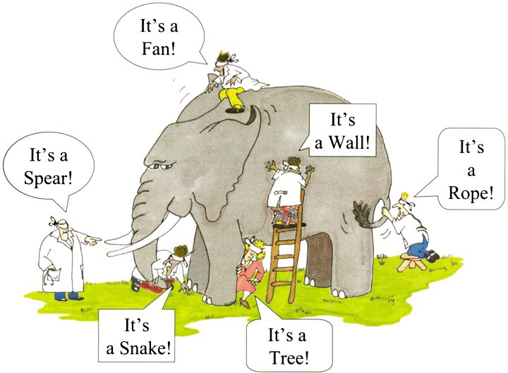
Notes:
Limited knowledge and limited consciousness gives a limited view of the world. This picture illustrates an old story. Each person here has their vision restricted, and they’re only touching one isolated part of the elephant. They’re all touching the same thing, but they only feel a small part, and they mistake that for the whole reality. Human beings can even create conflicts over their chosen perception of reality, and feel everyone else is wrong. This isn’t helpful for society, an as we can see, the elephant doesn’t seem to like it either!

Slide 11

Notes:
Once they can see, the parts are seen in connection with the whole. And they can stop disagreeing! Knowing and appreciating the whole truth is much more useful, exciting, and fulfilling. And it unifies people.

Slide 12
Perception is now estimated to consist of 80 to 90% memory with as little as 10% coming from input from the senses about our environment. This thought alone is a paradigm shift!
“If visual sensations were primarily received rather than constructed by the brain, you’d expect that most of the neuronal fibers going to the brain’s primary visual cortex would come from the retina. Instead, scientists have found that only 20% do; 80% come downward from regions of the brain governing functions like memory.” (Gawande, 2008, para 40)
Notes:
Research in the last decade is also emphasizing the role of memory in providing the right information to produce optimal human behavior. Experience encourages us to think of perception through the senses as providing us with an accurate picture of the external world. However, leading British neuropsychologist Richard Gregory (2009) and others believe
But this is supported by scientific studies of brain-anatomy and visual sensations:
Perception and the way we see the world are really due to our inner state of being.
This is Paradigm shift –from looking for answers and fulfillment in the relative changing world – to finding fulfillment within.

Slide 13
The more expanded the field of our consciousness, the clearer perception and understanding will be, and ultimately any action based on it will be more appropriate, effective, and fulfilling.
Notes:
This idea that what we need most in life can be found within is an ancient one.

Slide 14

Perennial
Philosophy
Notes:
It’s been called the Perennial Philosophy.
“perennial”: Adjective: lasting or existing for a long or apparently infinite time
A perennial plant is one that comes back year after year
The “perennial philosophy” refers to ideas or principles that occur repeatedly. They are seen over and over again.
These ideas or principles are not limited to one single point in time or one geographical location. They can be found throughout history, and throughout the world.

Slide 15
What are these principles that many traditions have in common?
At the basis of the extraordinary diversity of the universe is a field of unity, sometimes termed the ground of being, in which everything has its being and apart from which nothing could exist.
Human beings are capable of experiencing this underlying transcendental reality directly, deep within themselves.
The purpose of life is to discover and experience this ultimate reality, to reconnect with the underlying essence of life. To do so is to realize one’s true nature, and to transform and fulfill one’s life.
– Craig Pearson in The Supreme Awakening
Notes:
However, this Perennial Philosophy has been perennially unfulfilled. This was the Greek philosopher, Heraclitus’s regret. He called this underlying essence of life, Logos, a transcendental, universal law, but even though he knew it was universal, he saw that people rarely experienced or benefited from it…

Slide 16
“Although this Logos is eternally valid, yet men are unable to understand it…although all things come to pass in accordance with this Logos, men seem to be quite without any experience of it (fr. 1). Although intimately connected with the Logos, men keep setting themselves against it (Heraclitus, fr. 64).
Notes:
The historian Will Durant expressed the same concern:
(Wheelwright, Trans., 1959 pp. 19, 68)

Slide 17
How can this feeble brain, that aches at a little calculus, ever hope to understand the complex immensity of which it is so transitory a fragment? Not that the intellect is useless; it has its modest place, and serves us well when it deals with relations and things; but how it falters before the eternal, the infinite, or the elementally real! In the presence of that silent reality which supports all appearances, and wells up in all consciousness, we need some other organ of perception and understanding than these senses and this reason. (Durant, 1935, p. 412)
Notes:
Despite the disappointment of not knowing how to find it, the perennial need for the experience of this transcendental state remains through the centuries. It remains in our collective memory; a deep need to know the ultimate reality and our relationship to it.

Slide 18

Knowledge is structured in Consciousness
Notes:
But this is one of the founding goals of MIU: To develop the full potential of the individual by developing their innermost value, consciousness. This was the original motto of MIU:
Knowledge is structured in Consciousness

Slide 19
Knowledge of the Knower as the Basis of all Knowing
Expanding the
Container of Knowledge
Notes:
So here we start with the knower. We expand the container of knowledge, so that we can more easily and comfortably learn and grow, fitting more knowledge and more understanding in our ever expanding container.
One of the ways we understand ourselves in a more expanded way is to see ourselves as a part of nature. Maharishi outlined 16 principles that exist throughout creation

Slide 20
16 principles of Creative intelligence
Universal Principles in nature
Notes:
Recognizing these principles around us and within us helps us to understand the nature of life at deeper levels.

Slide 21

We are a part of nature. These 16 principles are a part of us.
We are a part of nature.
These 16 principles are a part of us.
Notes:
These underlying principles are seen in nature and in our own thoughts and actions, unifying our inner and outer worlds, and showing us how to function more in harmony with nature’s functioning.

Slide 22

1. The nature of life is to grow
1. The nature of life is to grow
Even in the face of obstacles, life will grow
Notes:
Progress, evolution, and growth are the nature of life. Creative intelligence expresses itself in the direction of more and more, in the direction of greater happiness, greater knowledge, greater achievement, more fulfillment.
Practicing TM is like being a wise gardener who waters the root of a tree instead of attending to each leaf, nourishing the whole tree in one stroke. The nature of life is to grow.

Slide 23
1. The Nature of Life is to Grow
TM can be a tool for our maximum growth: it sharpens the mind and it enhances all three factors of mind/brain development: Individual psychology, level of brain integration and frequency of peak experiences.
Higher mind-brain development is the basis of higher performance in any vocation or activity – Dr. Travis.

Slide 24
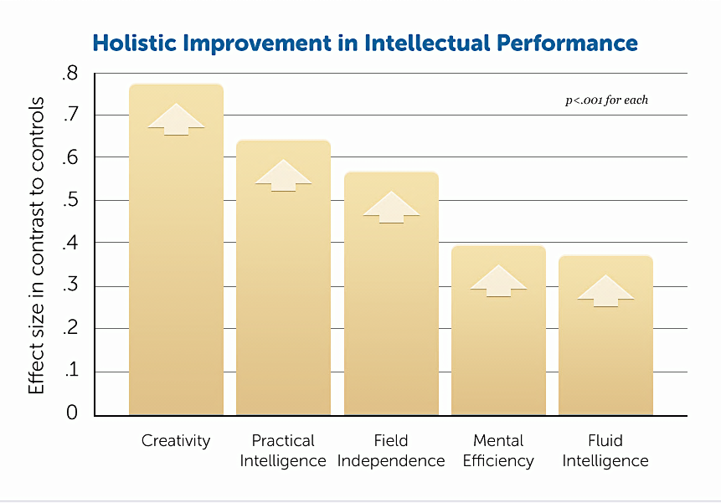
1. The Nature of Life is to Grow

Slide 25
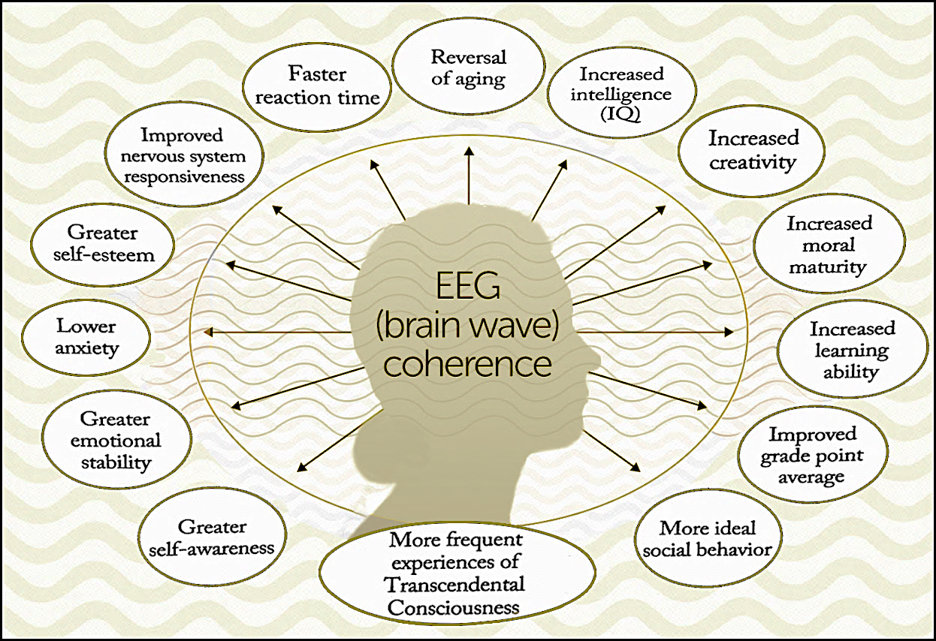
1. The Nature of Life is to Grow

Slide 26
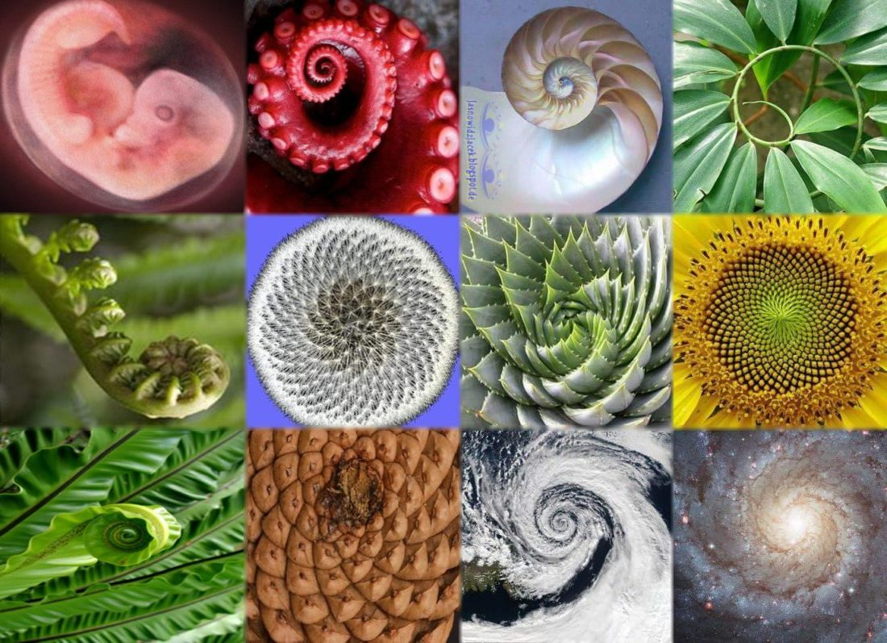
2. Order is Present Everywhere

Slide 27
2. Order is Present Everywhere
The functioning of creative intelligence is such that under similar circumstances, similar results occur. Just this phenomenon explains why there is harmony in creation, not chaos. An apple tree only produces apples; it does not produce guavas. There is something definite; nothing is random, and it is this specific value of creative intelligence that automatically carries out evolution everywhere.”
— Maharishi

Slide 28


2. Order is Present Everywhere
But we don’t see order everywhere. Without a connection to the source of order in the unified field of consciousness, even with the best of intentions humans can disturb the order of nature.

Slide 29
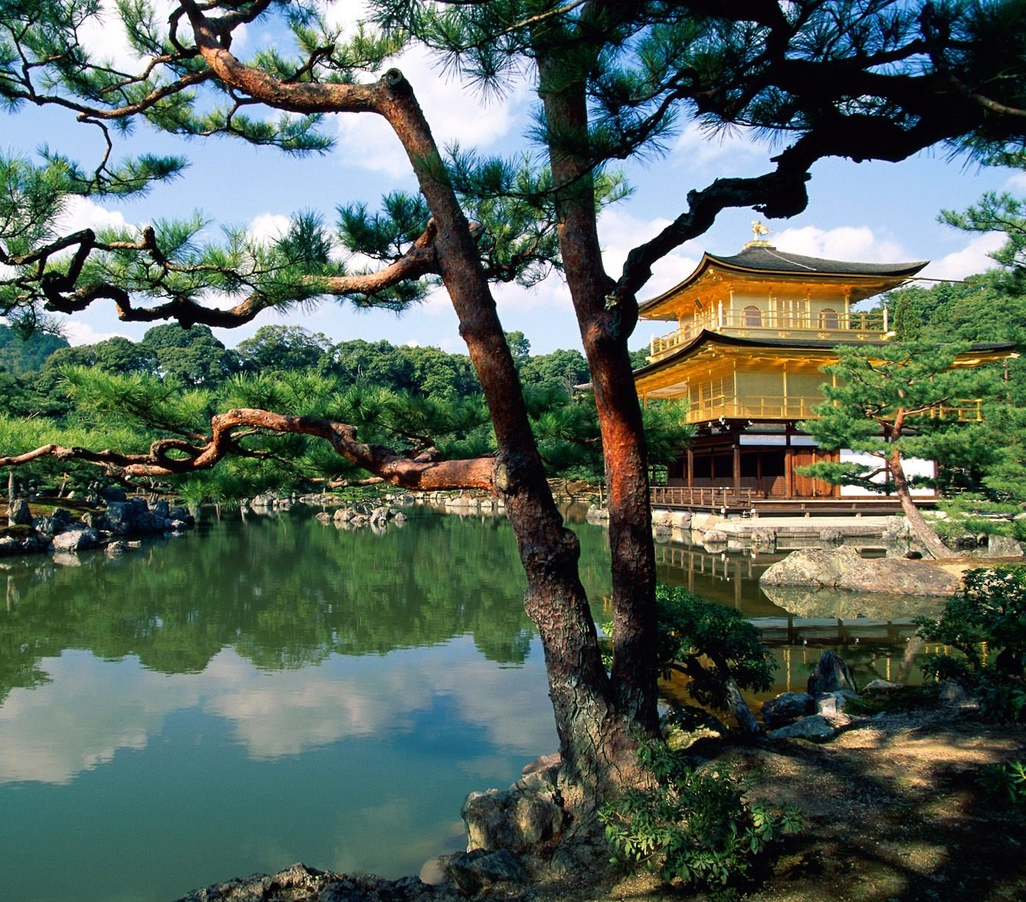


2. Order is Present Everywhere
When we tap into the perfect order inherent in the transcendental field, it enables us to express that order in creative ways and progress in life, for our own good and the good of our community and the world.

Slide 30
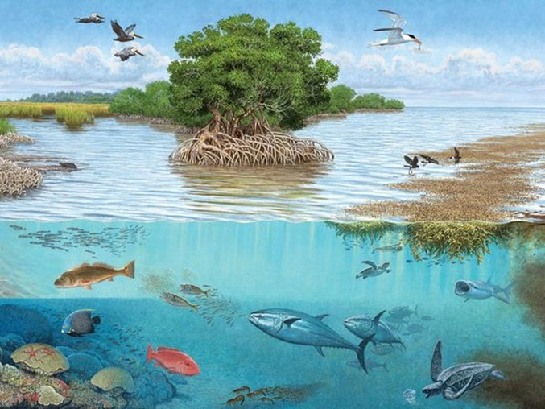
3. Life is Found in Layers

Slide 31

3. Our Life is Found in Layers
Action and Speech
Thinking
Intuition and Feeling
Transcendental
Notes:
We want to be all we can be. We want to be a whole person. To know ourselves fully. In time, TM helps to open up all the layers that make us who we are. Then life is richer and fuller.

Slide 32
3. Our Life is Found in Layers
All four levels of life have their area of importance and interact for greatest effect:
Action without thought is reckless and unguided, thought without intuition lacks the seed of progress, and intuition without a clear connection to the transcendent jeopardizes its validity.

Slide 33
3. Our Life is Found in Layers
“Indeed, it is not intellect, but intuition which advances humanity” – Einstein
Einstein explained that intuition springs from a connection to the cosmic [transcendental] experience, and asserted, “that the cosmic experience is the strongest and noblest driving force behind scientific research”

Slide 34

4. Outer depends on inner
Notes:
Diet: Drink more water; Limit or eliminate sugar/alcohol/drugs/tobacco (caffeine is a drug); Eliminate or reduce processed foods.

Slide 35
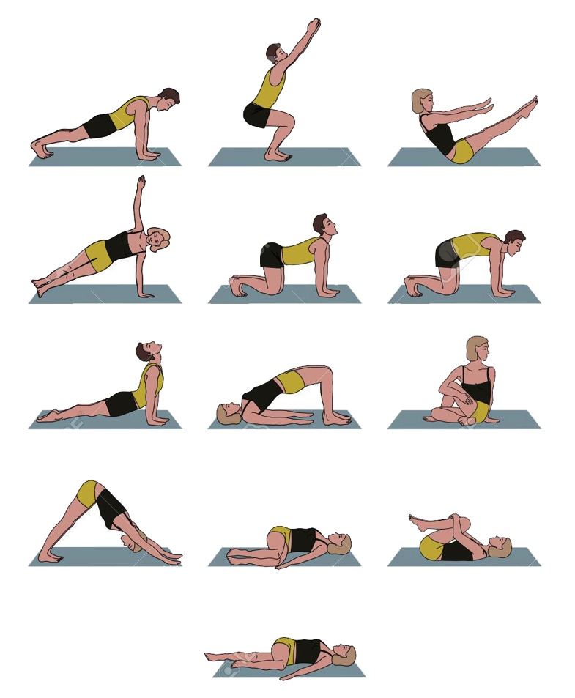
4. Outer depends on inner
Notes:
Exercise dependent on age, physical ability, body type, health issue; Exercise at least 30 minutes a day (Cardiovascular); Just be active – Enjoy a variety of activities; sports, hiking, biking – play!
Do Yoga

Slide 36
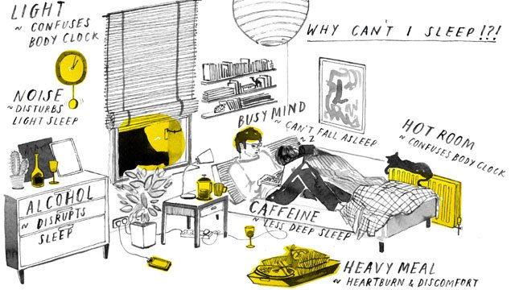
4. Outer depends on inner
Notes:
Sleep: ideally 10pm to 6 am; Shut off electronics around 9:00 p.m; Sleep in a dark, cool setting; Set a consistent sleep schedule.

Slide 37
4. Outer depends on inner
Notes:
TM: ideally 2x a day; Set a consistent schedule for when you meditate, but also be flexible – life is always changing; No straining, no effort in the practice.

Slide 38

5. Seek the highest first
Notes:
Circadian rhythms…

Slide 39

5. Seek the highest first
Notes:
What’s the highest? The highest is the deepest – TC If we want to accomplish something, the quickest way will be to make friends with the King, and then all of his ministers and assistants will help you.
—When we experience the transcendent where all the laws of nature reside, then nature rises up to support all our activity.

Slide 40


5. Seek the highest first
Notes:
The merchant was in such a hurry that he didn’t think he had time to go to the bank before going to the market, so he rushes to the market, but can’t be effective there because he has no money.
—No matter how busy we are, it will always be wise to take the time to take care of ourselves and meditate so that we bring all we have to every project at work, and to all our family and friends. “One can only give from what one has” – Maharishi.

Slide 41

6. Rest and activity
are the steps of progress
Notes:
We live in a time of uncertainties and rapid change. It can be challenging to keep progressing yet maintain balance, to fulfill our goals and desires without accumulating stress and fatigue in the process.
Analogy: One foot must be at rest, to provide the basis for the other foot to move forward.
Examples from nature; The earth balances the activity of summer with the silence of winter, the activity of the day and the rest of the night. Life giving blood circulates through the body due to the rest and activity phases of the pumping heart. Nothing just keeps going without resting.
Deeper rest is the basis of more dynamic, more fulfilling activity. TM is an effective way to experience deep rest in a short amount of time, helping us to progress more quickly in life.
Rest is the basis of activity. Rest comes in many forms; the sleep of night, TM, taking a break from our work, etc., the traditional day of rest each week in most societies.

Slide 42
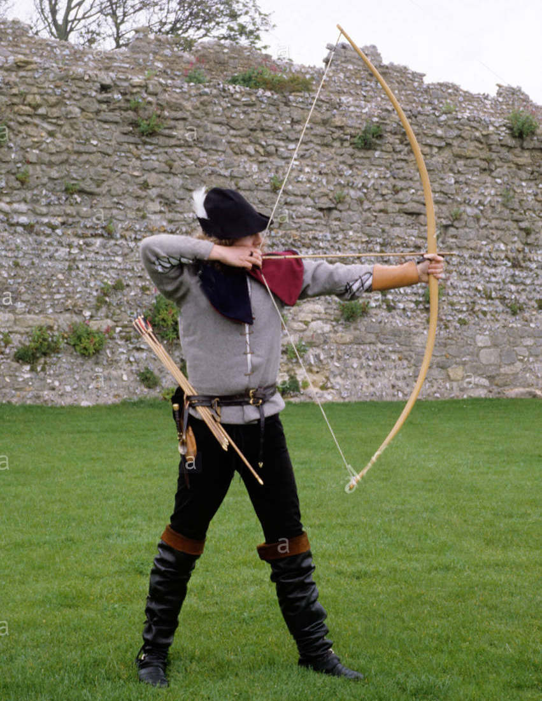

6. Rest and activity
are the steps of progress
Notes:
Arrow analogy: To shoot an arrow successfully, it is first necessary to draw it back on the bow. In this state of rest it has great potential energy. When it is brought back to the fullest possible extent, then it possesses the greatest dynamic power and can fly forward to hit the target.
In any creative process, whether programming or writing music, we have moments of rest or silence from where we get the inspiration to move on to the next idea.

Slide 43
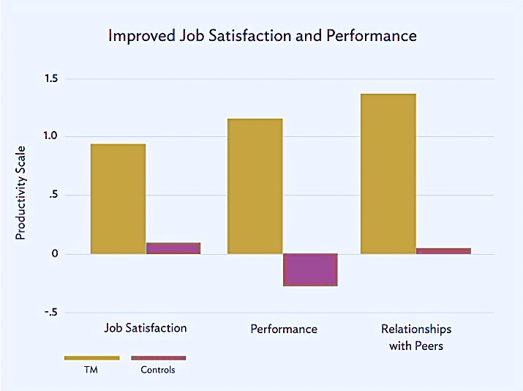
7. Enjoy greater efficiency and accomplish more
Notes:
With a deeper reservoir of energy, intelligence and creativity to draw from, we become more efficient and productive….

Slide 44
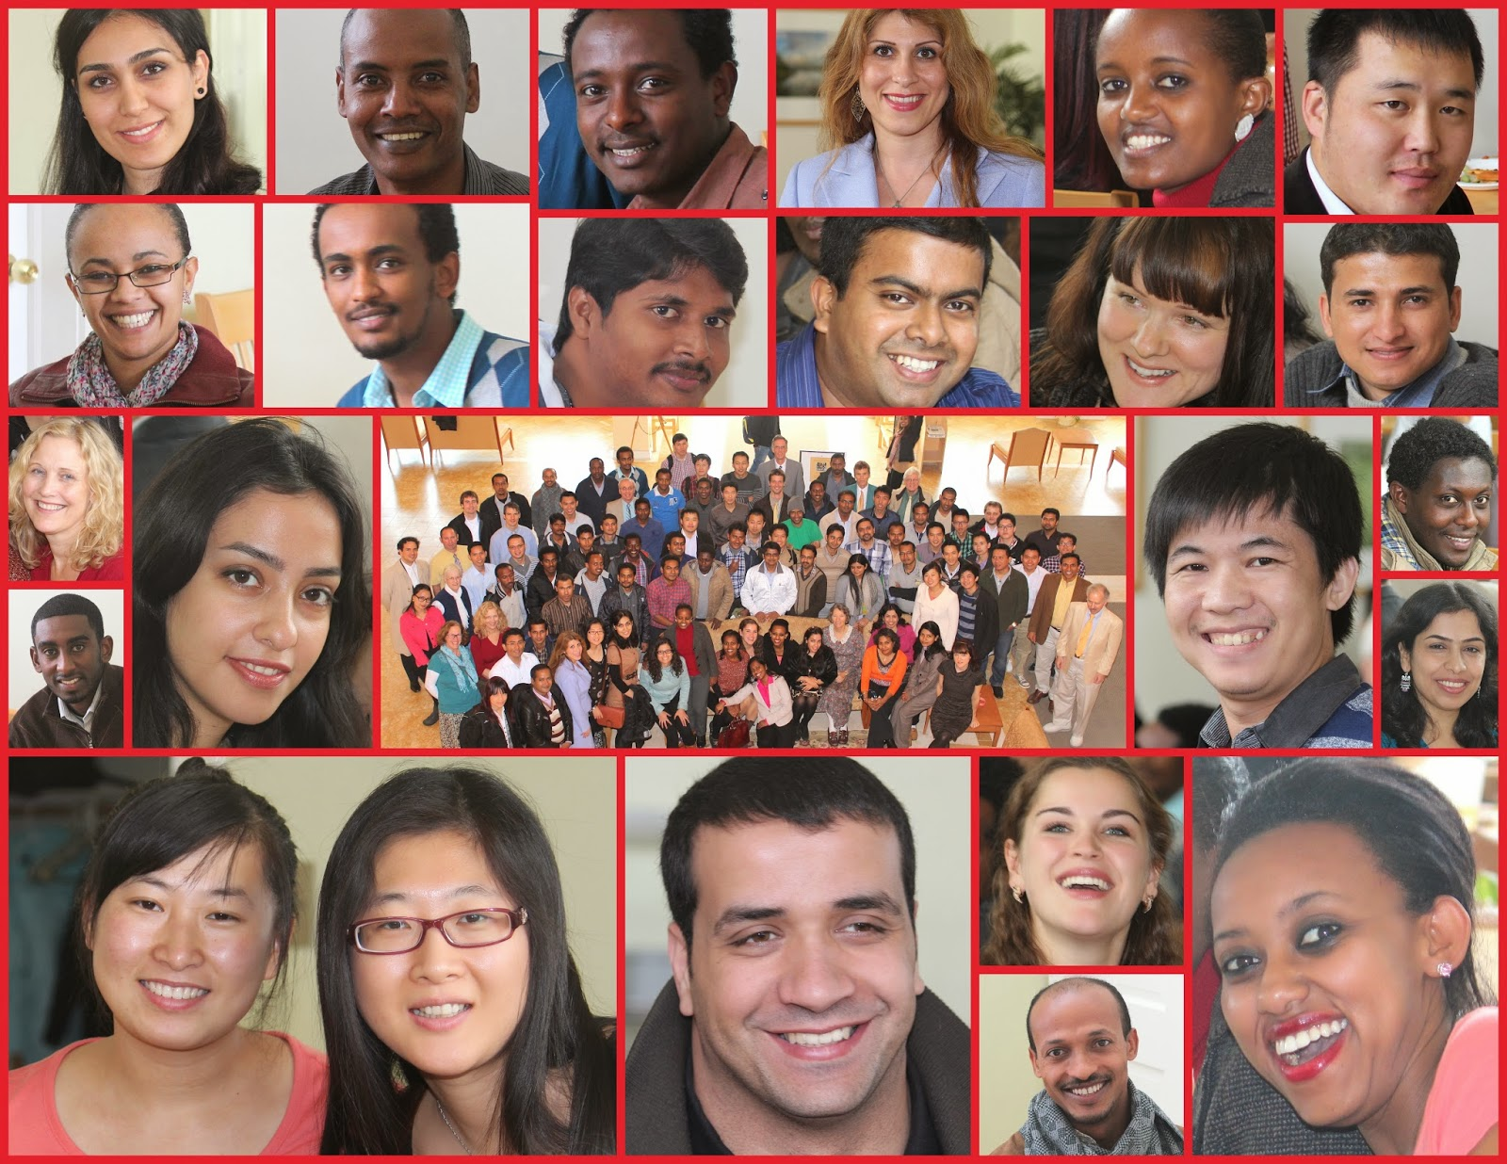
7. Enjoy greater efficiency and accomplish more
Notes:
…and have time to enjoy our achievements — and also have time to enjoy our family and friends.

Slide 45
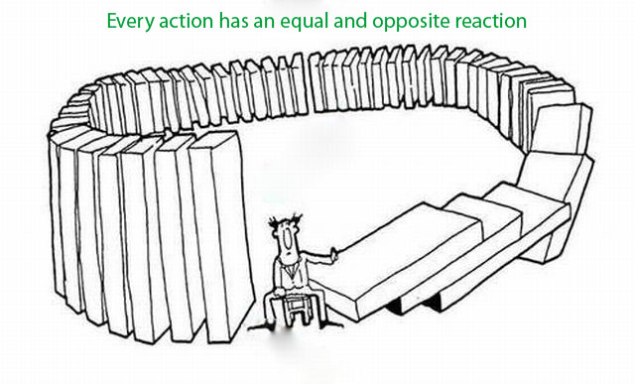
8. Every action has a reaction
Notes:
So its good to align ourselves with natural law at its source, so we are more capable to perform action which is right, and will bring a good reaction to us!

Slide 46

9. Purification leads to progress
Notes:
Analogy: snow plow or shovel – the way must be cleared before we can advance. Otherwise, we aren’t going anywhere!
Stress inhibits our progress in life and carries physical and mental risks. The body naturally wants to get rid of stress and Transcendental Meditation provides a simple, natural, effective way to eliminate stress. Purification of stress leads to progress.

Slide 47

9. Purification leads to progress
Notes:
As a by-product, TM releases stress and purifies our nervous system in a very natural way.

Slide 48

9. Purification leads to progress
Notes:
If there is stress in the mind and body it must be released in order for us to become free of that which is not really us. Stress inhibits us from living our full potential. Relaxation and other good feelings during and after TM comes from the release of stress and expansion of the mind as we transcend and experience pure consciousness.
So the purification of these stresses leads us to more and more progress, happiness and fulfillment in our life.

Slide 49
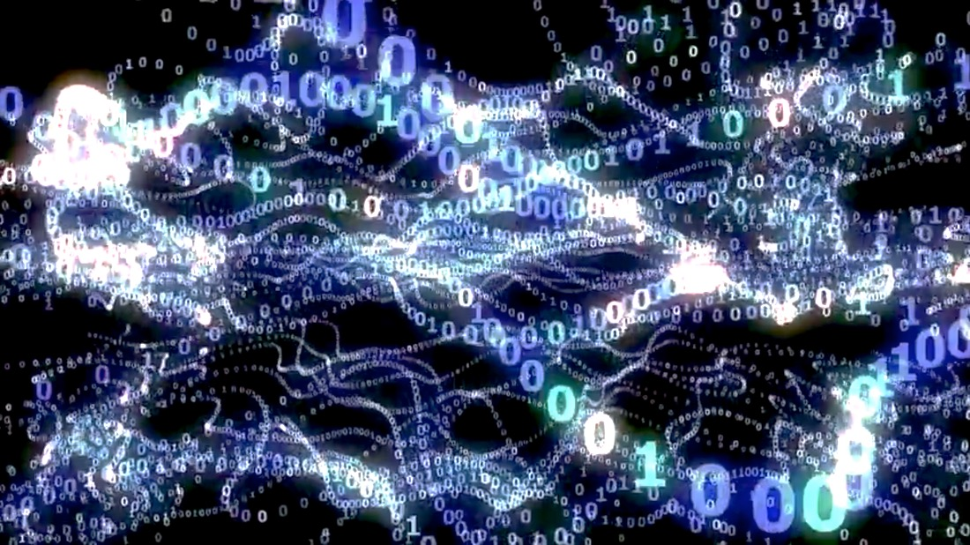
10. The field of all possibilities is the source of all solutions
Notes:
“The unified field and Transcendental Consciousness share fundamental qualities. Both are unbounded, infinitely dynamic, self-interacting fields of pure intelligence” – Dr. Hagelin. STC states that TC is the home of natural law, the field of all possibilities. Quantum physics states that the unified field is the source of all the laws of nature, the unification of all the force and matter fields that create the manifest reality. This field of pure intelligence, being the source of everything, also contains the solution to everything.

Slide 50
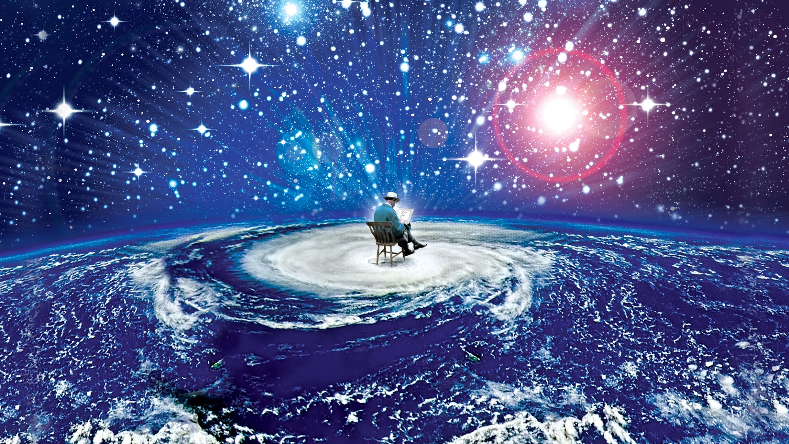
10. The field of all possibilities is the source of all solutions
Notes:
“The unified field is not down deep somewhere, not out in space, not far away. It is all-pervading. Everything is made out of that. Everything is only a fluctuation of that, is nothing but that.” – Dr. Pearson.
This is our own Transcendental Consciousness.
“The unified field and Transcendental Consciousness share fundamental qualities. Both are unbounded, infinitely dynamic, self-interacting fields of pure intelligence” – Dr. Hagelin. STC states that TC is the home of

Slide 51

11. Being is the basis of thought, thought leads
to action, action leads to achievement,
achievement leads to fulfillment
Notes:
Being, Transcendental Consciousness is the basis, the foundation for everything else. It is the unchanging field that supports all change and growth in life.

Slide 52


12. Knowledge is gained from inside and outside
Notes:
Knowledge comes from information coming through our senses about the outside world, it also comes from deep within, from the level of intuition and the transcendent.
British neuropsychologist Richard Gregory (2009) believed perception to be largely stored knowledge or memory: “Perception is based on ancient, innate, and on more recent learned knowledge from the past, with present information from the senses for real-time behavior” (p. 226). He estimated that visual perception may consist of eighty to ninety percent memory with as little as ten percent coming from input from the senses about our environment. This is supported by studies of brain-anatomy and visual sensations:
If visual sensations were primarily received rather than constructed by the brain, you’d expect that most of the fibers going to the brain’s primary visual cortex would come from the retina. Instead, scientists have found that only twenty percent do; eighty percent come downward from regions of the brain governing functions like memory. (Gawande, 2008, para. 40)
So all the more reason to develop our ability to function from the deepest level of our existence.

Slide 53


13. Knowledge is structured in consciousness
Notes:
When we are sleepy and dull nothing seems interesting and it’s difficult to learn. When our consciousness is clear learning is an enjoyable adventure.
The knower is primary. Without the knower, there is no real foundation for knowledge.

Slide 54

13. Knowledge is structured in consciousness
Notes:
“The world is as you are.” Analogy: Green colored glasses makes everything green. How we see changes the way we understand the world. The clearer our consciousness the clearer our understanding of any project we’re working on, or any situation we find ourselves in.

Slide 55
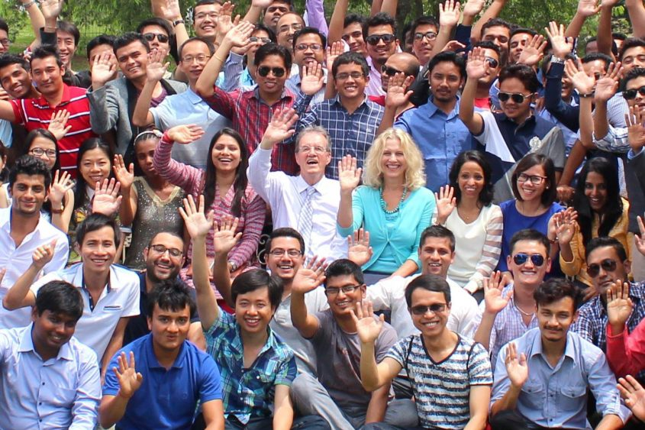
14. Harmony exists in diversity
Notes:
When the reality of unity underlies the experience of diversity it creates a harmonizing effect.

Slide 56

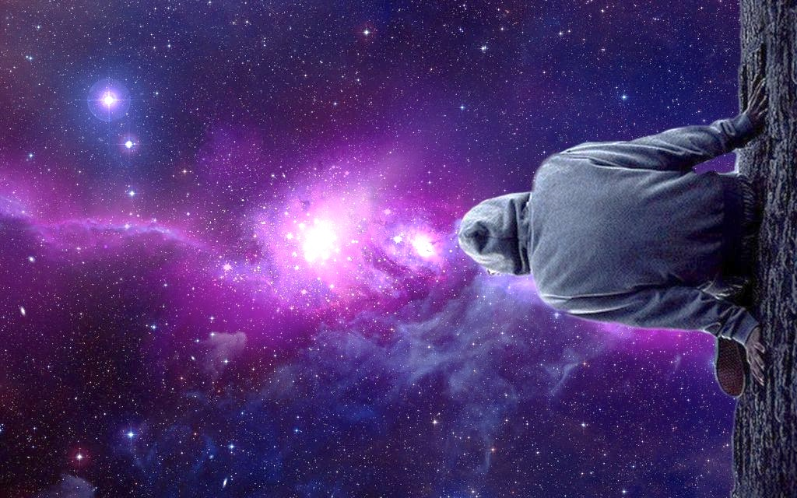

15. The whole is contained in every part
Notes:
Every team member represents the whole team. Every drop contains the essence of the ocean in it. Every individual consciousness contains the unbounded field of consciousness within them. It’s important for every part to remain connected with wholeness.

Slide 57

16. The whole is greater than the sum of the parts
Notes:
☺ In the relative sphere of life…

Slide 58
16. The whole is greater than the sum of the parts
Notes:
And in the deeper sphere of life — Our unbounded true nature is greater than the sum of all the parts that make up who we are in our day to day life.

Slide 59
16. The whole is greater than the sum of the parts
“Place yourself in the middle of the stream of power and wisdom which animates all whom it floats, and you are without effort impelled to truth, to right and a perfect contentment…. Then you are the world, the measure of right, of truth, of beauty. If we will not be mar-plots [someone who spoils a plan] with our miserable interferences; then the work, the society, letters, arts, science, and religion of men would go on far better than now, and the heaven predicted from the beginning of the world, and still predicted from the bottom of the heart, would organize itself, as do now the rose and the air and the sun.”
— Emerson
Notes:
This is a perfect description of aligning ourselves with wholeness and living according to nature as simply as the rose and the air and the sun.

Slide 60


